Slide 1
Introduction
to Statistical Methods
ISM Team

Slide 2


Session 4
(16th Aug 2026)
Baye’s theorem and Naïve Bayes theorem

Slide 3
Revise
Descriptive Statistics
Review of Set Theory, Counting Principles
Probability, Axioms of Probability
Addition and Multiplication Rule of Probability
Conditional Probability and Independent events
Total Probability

Slide 4
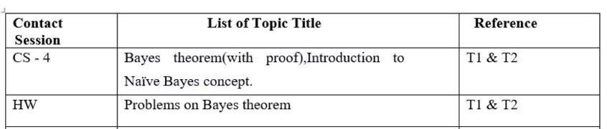
Contact Session 4

Slide 5

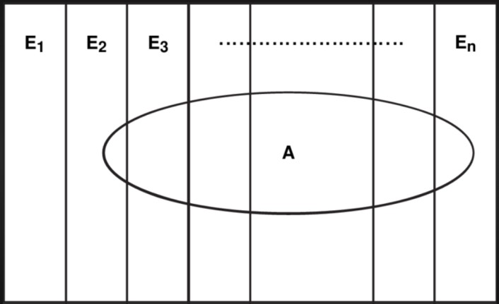
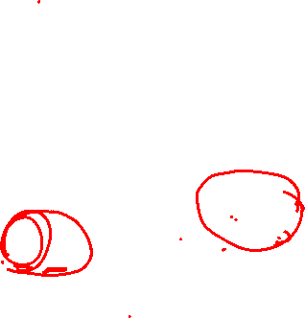
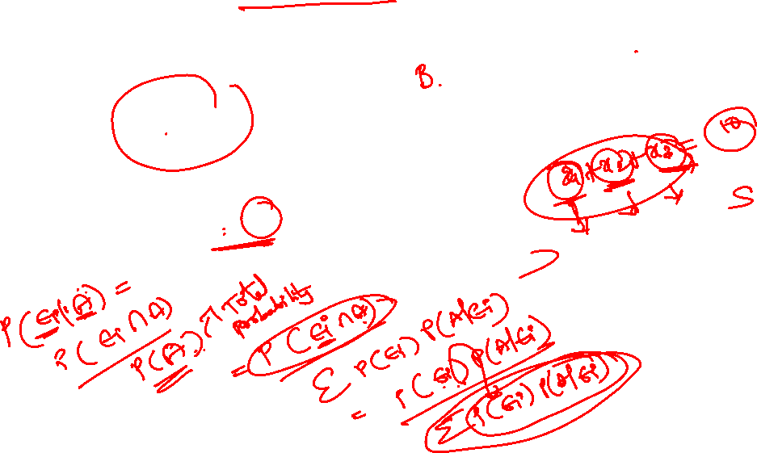
BAYE’S THEOREM:
Suppose that E1, E2 , ---------En are mutually exclusive events of a sample space “ S ” such that P ( Ei ) > 0 for i = 1,2,3, ---------n and A is any arbitrary event of “ S ”
n
such that P (A) > 0 and A⊆
U Ei then the conditional probability of Ei given A
i = 1
P(E )P(A / E )
for i = 1,2,3………n is given by P(Ei /A) = _{n}
i i
∑ P(E )P(A / E )
i
i i

Slide 6
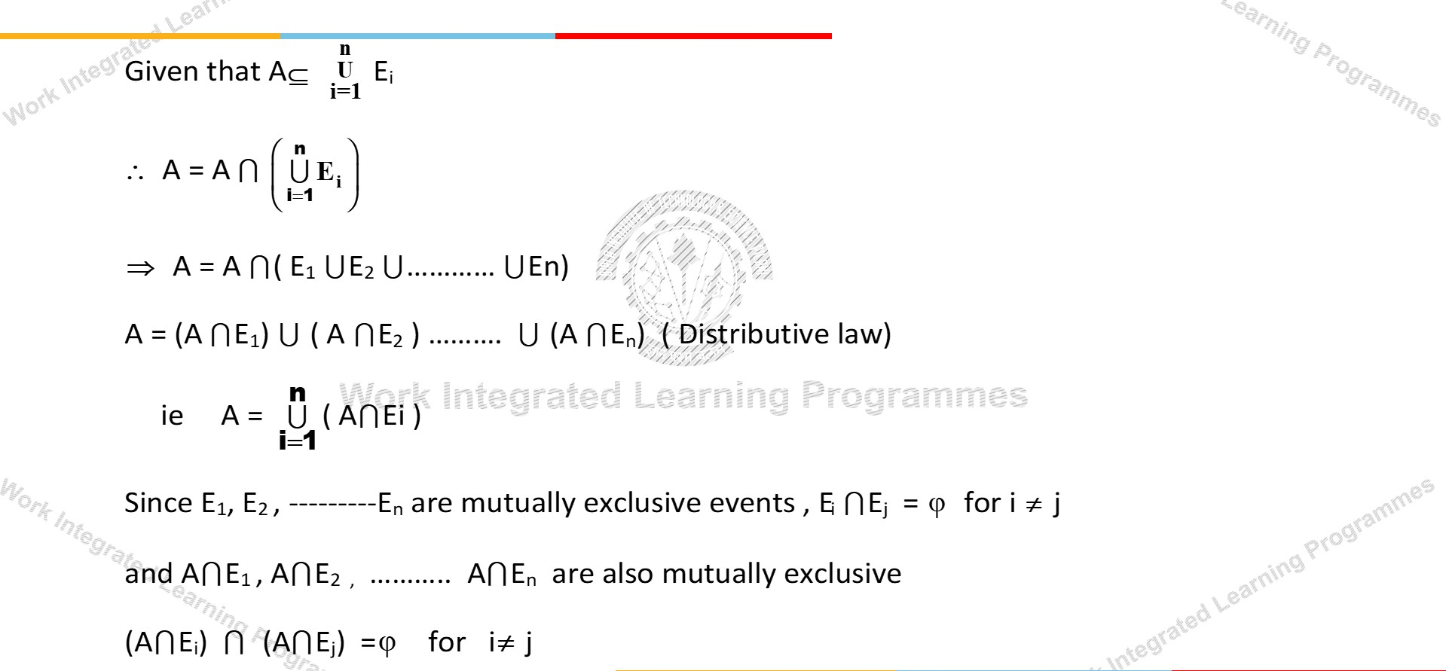
Proof:

Slide 7










Proof:(Continuation)
Applying the addition rule for mutually exclusive events, we have
P(A) = P((A E1) (A E2 ) …. ( A En ))
= P (A E1) + P (A E2 )……+ P (A En )
n
P(A) = P( ^{n} (A E )) =
∑
i=1
P(A Ei) --- (1)
∪
i
i=1
From multiplication rule we have
P(A Ei) = P(Ei) P ( A/Ei) ----- (2)
Substituting (2) in (1) we have
n
P(A) =
∑
i=1
P(Ei) P ( A/Ei) - (3)[Rule of total probability OR
Rule of elimination ]

Slide 8
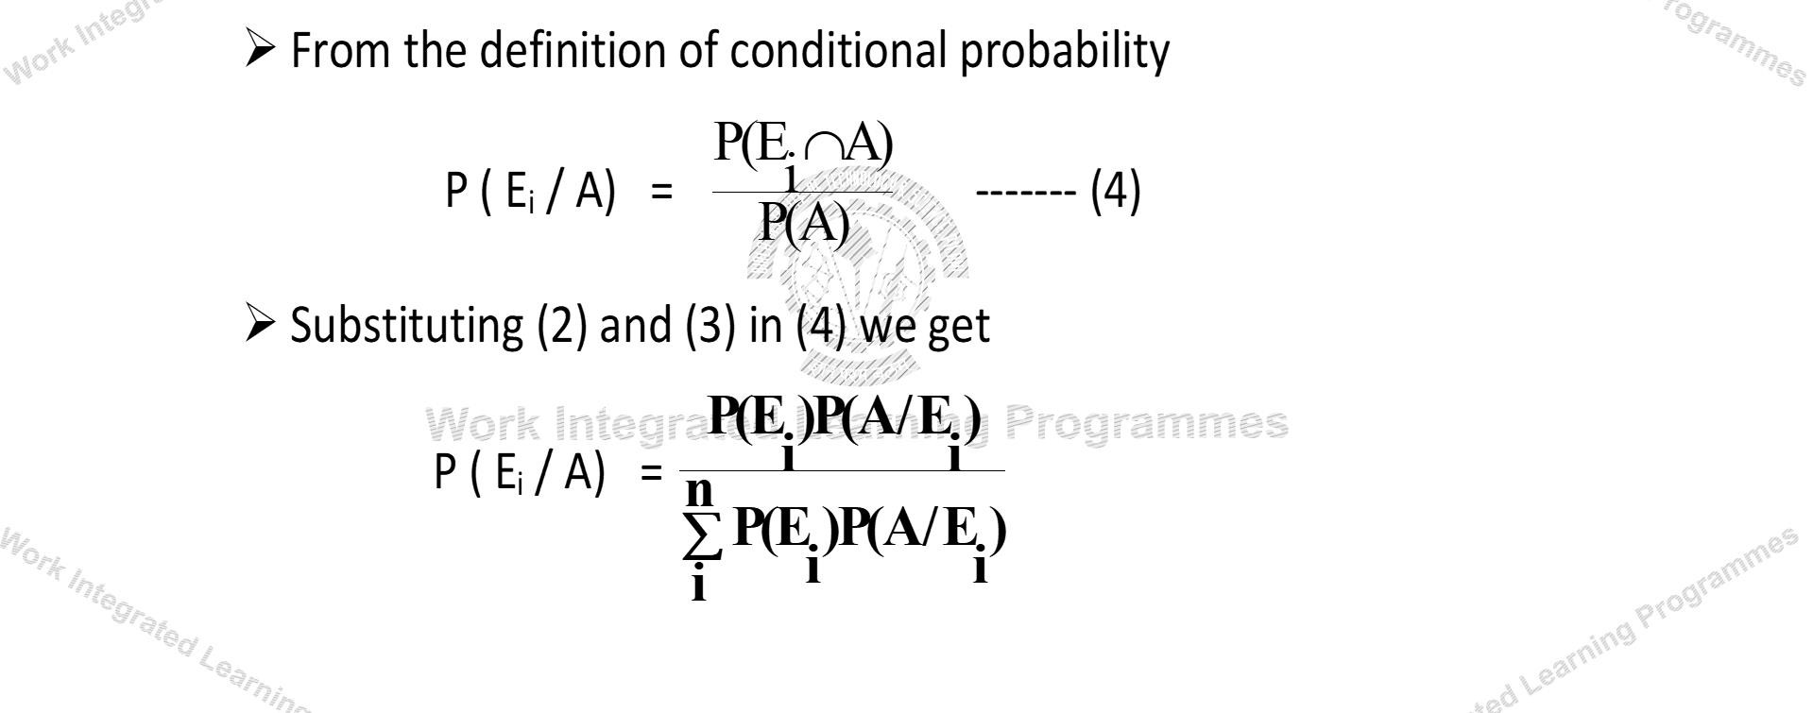
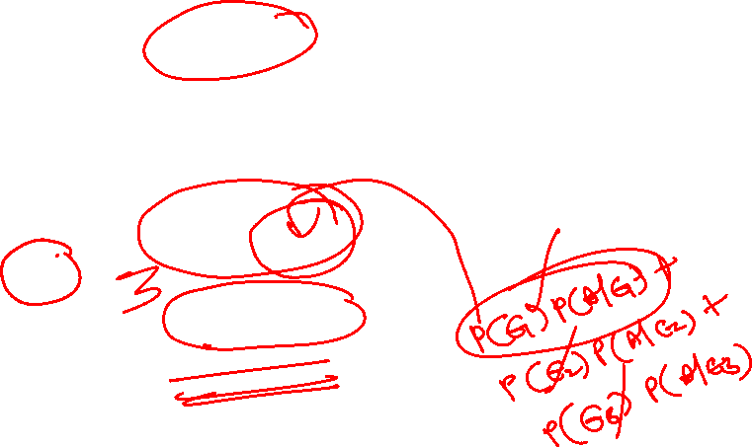
Proof:(Continuation)

Slide 9
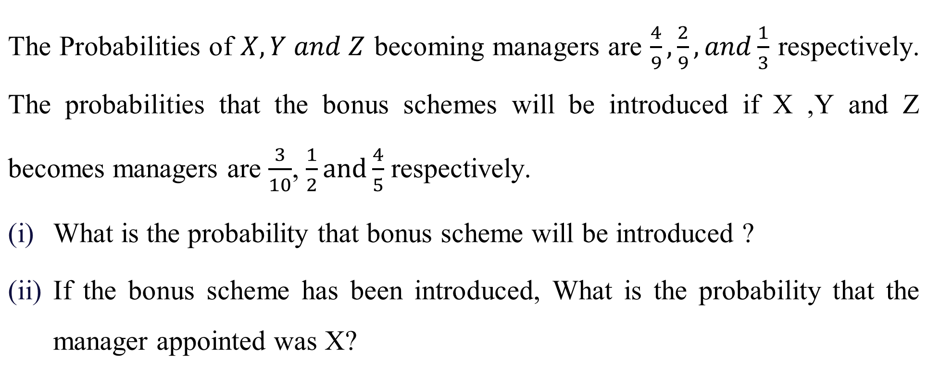
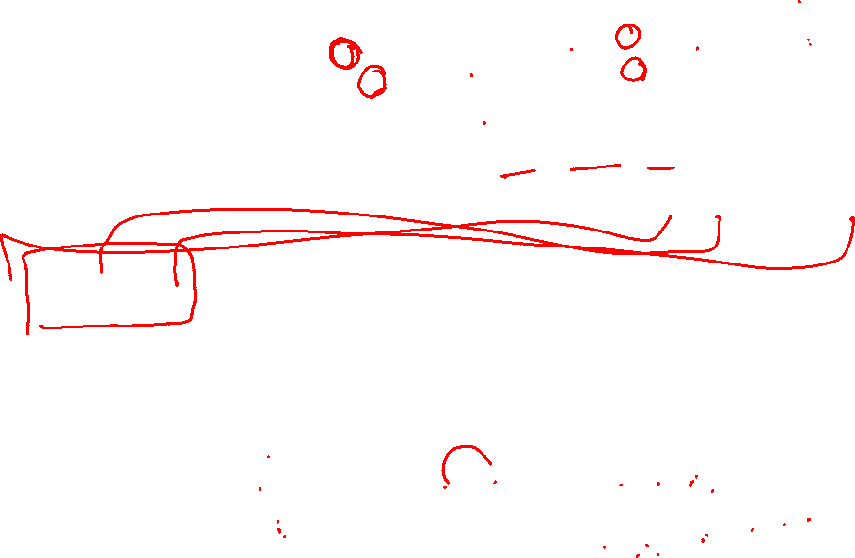
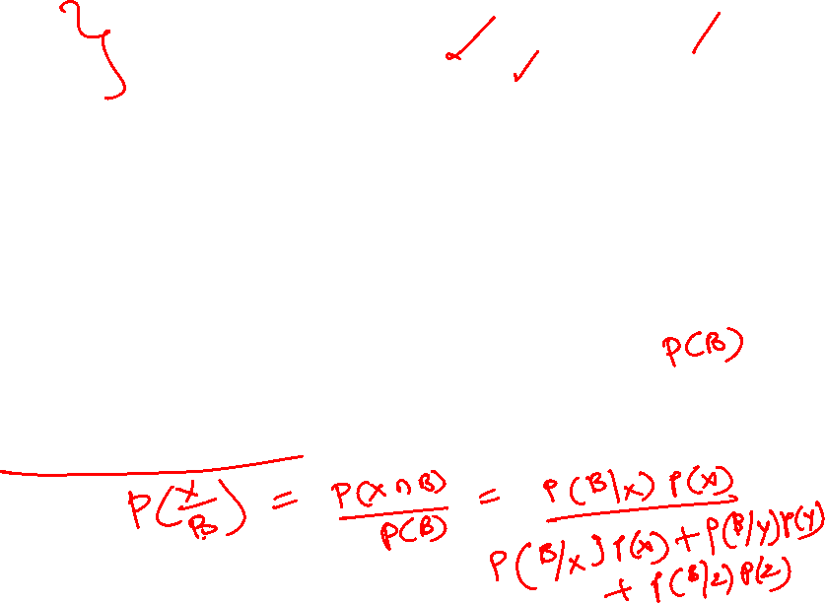
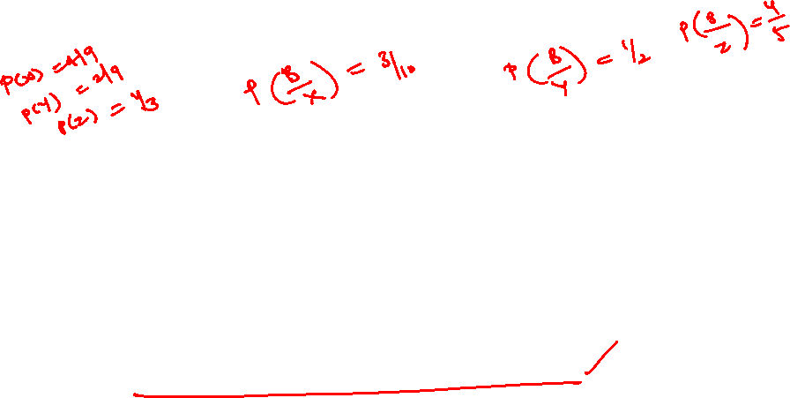
Example:1

Slide 10
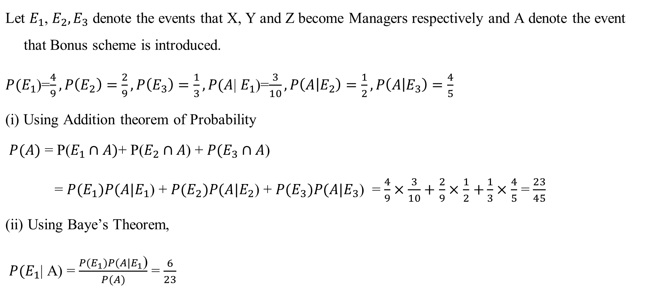

Solution:

Slide 11

Example:2
In a neighborhood, 90% children were falling sick due to flu and 10% due to measles
and no other disease. The probability of observing rashes for measles is 0.95 and for flu is 0.08. If a child develops rashes, Find the child’s probability of having flu.

Slide 12

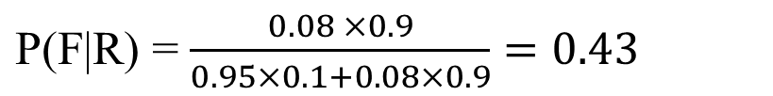

Solution:
Let, F: children with flu M: children with measles R: children showing the symptom of rash
P(F) = 90% = 0.9, P(M) = 10% = 0.1
P(R|F) = 0.08, P(R|M) = 0.95

Slide 13
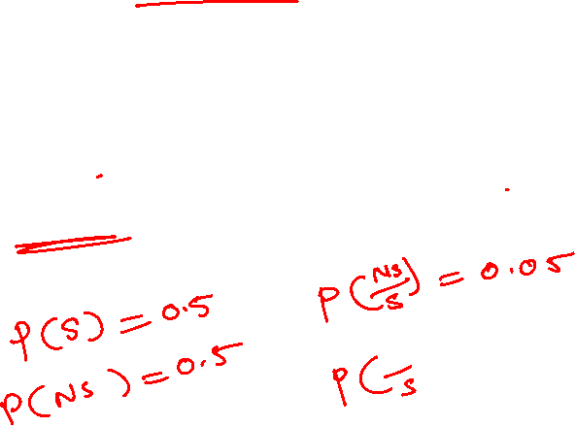
Example:3
It is estimated that 50% of emails are spam emails. Some software has been applied to filter these spam emails before they reach your inbox. A certain brand of software claims that it can detect 99% of spam e-mails, and the probability for a false positive (a non-spam email detected as spam) is 5%.Now if an email is detected as spam, then what is the probability that it is in fact a non-spam email?

Slide 14
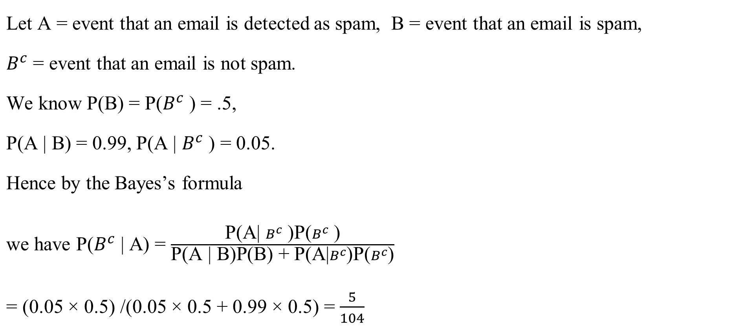

Solution:

Slide 15

Bayes' Theorem for Hypothesis
𝑃(𝐸 ∣ 𝐻)𝑃(𝐻)
𝑃(𝐻 ∣ 𝐸) =
𝑃(𝐸)
Where
𝑃(𝐻 ∣ 𝐸) : Posterior probability of hypothesis 𝐻 given evidence 𝐸.
𝑃(𝐻) : Prior probability of hypothesis 𝐻.
𝑃(𝐸 ∣ 𝐻) : Likelihood of evidence 𝐸 given 𝐻.
𝑃(𝐸) : Evidence probability, which acts as a normalization constant.
If 𝐻₁, 𝐻₂, … , 𝐻_{𝑛} are mutually exclusive and exhaustive hypotheses, the sum of their posterior probabilities is
always 1 : ෌
𝑛
𝑃(𝐻_{𝑖} ∣ 𝐸) = 1
𝑖=1
This holds because of the total probability of E accounts for all hypotheses.
This logic forms the core of the Naive Bayes classifier, widely used in:
Spam filtering
Sentiment analysis
Document categorization
Medical diagnosis prediction

Slide 16

Example 4
Email Spam Classification using Bayes’ Theorem
A machine learning model needs to decide whether an email is Spam (H₁) or Not Spam
(H₂) based on the presence of the word “offer” (E).
Given Data (from training corpus):
P(Spam) = 0.3 → 30% of all emails are spam
P(Not Spam) = 0.7 → 70% of all emails are not spam
P(“offer” | Spam) = 0.8 → 80% of spam emails contain the word “offer”
P(“offer” | Not Spam) = 0.1 → 10% of non-spam emails contain “offer”
Find the probability that an email is spam given that it contains “offer”.

Slide 17
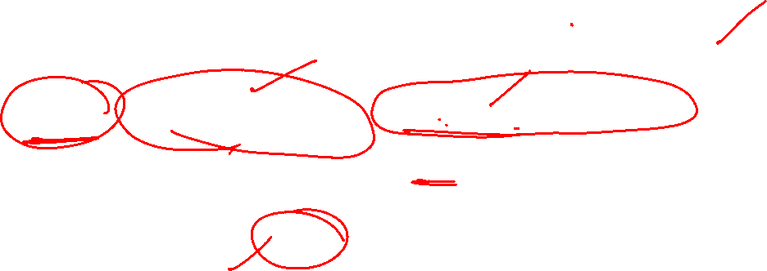
Example 4: Solution
Using Bayes’ Theorem:
𝑃(Offer / Spam )𝑃( Spam )
𝑃( Spam /𝑂𝑓𝑓𝑒𝑟) =
𝑃(𝑂𝑓𝑓𝑒𝑟)
𝑊ℎ𝑒𝑟𝑒
𝑃(𝑂𝑓𝑓𝑒𝑟) = 𝑃(Offer / Spam )𝑃( Spam ) + 𝑃(Offer / Not Spam )𝑃( Not Spam )
= (0.8)(0.3)+(0.1)(0.7) = 0.24+0.07 = 0.31
𝑃( Spam /𝑂𝑓𝑓𝑒𝑟) = ^{0.8𝑋0.3} = 0.774
0.31
If an email contains the word “offer”, there is a 77.4% probability that it is spam.

Slide 18
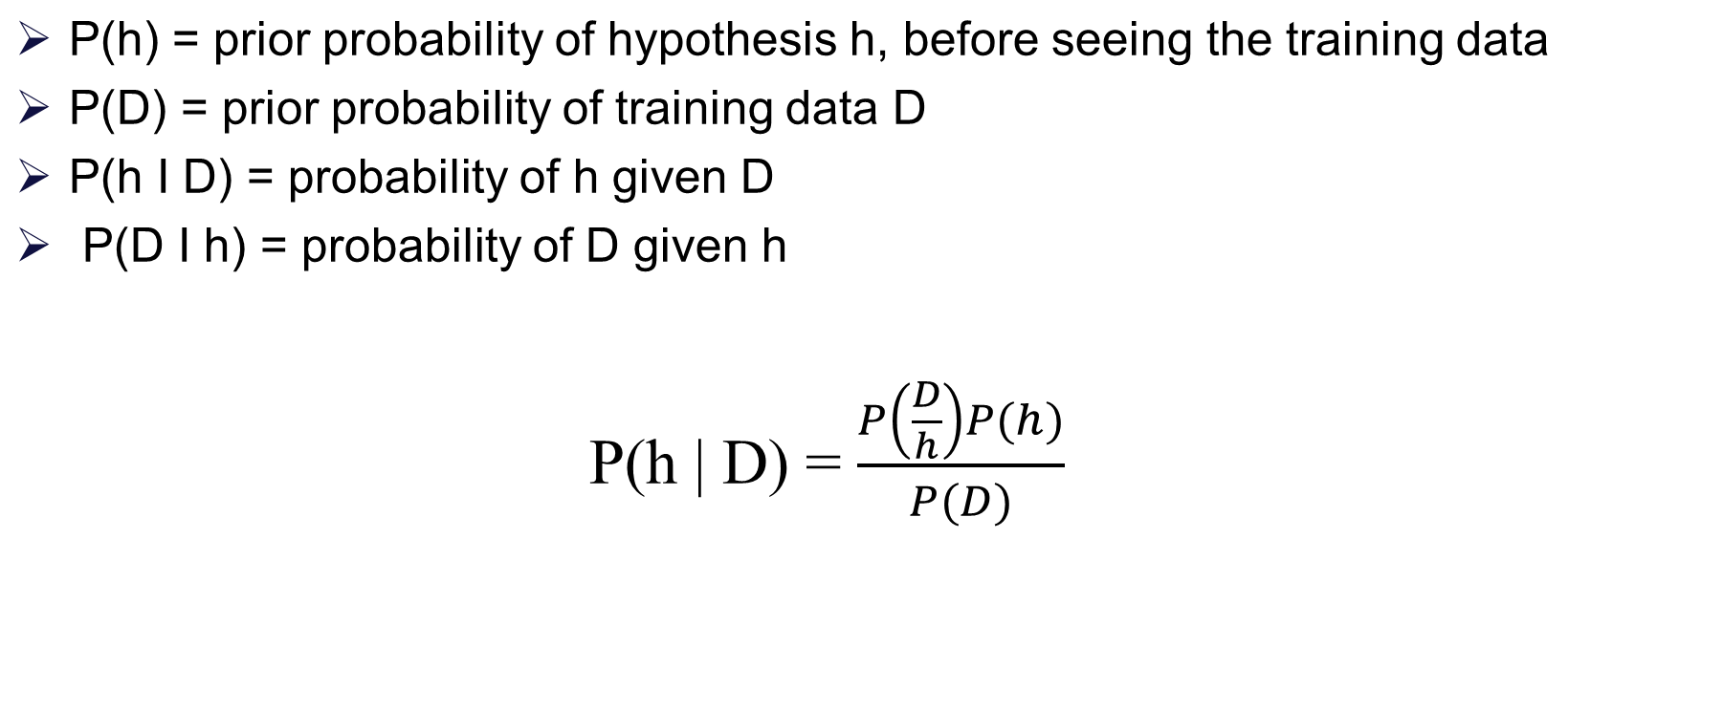
Baye’s Theorem

Slide 19

Features of Bayesian learning
Prior knowledge can be combined with observed data to determine the final probability of a hypothesis.
Prior knowledge is provided by asserting
prior probability for each candidate hypothesis, and
probability distribution over observed data for each possible hypothesis.
New instances can be classified by combining the predictions of multiple hypothesis, weighted by their probabilities.

Slide 20
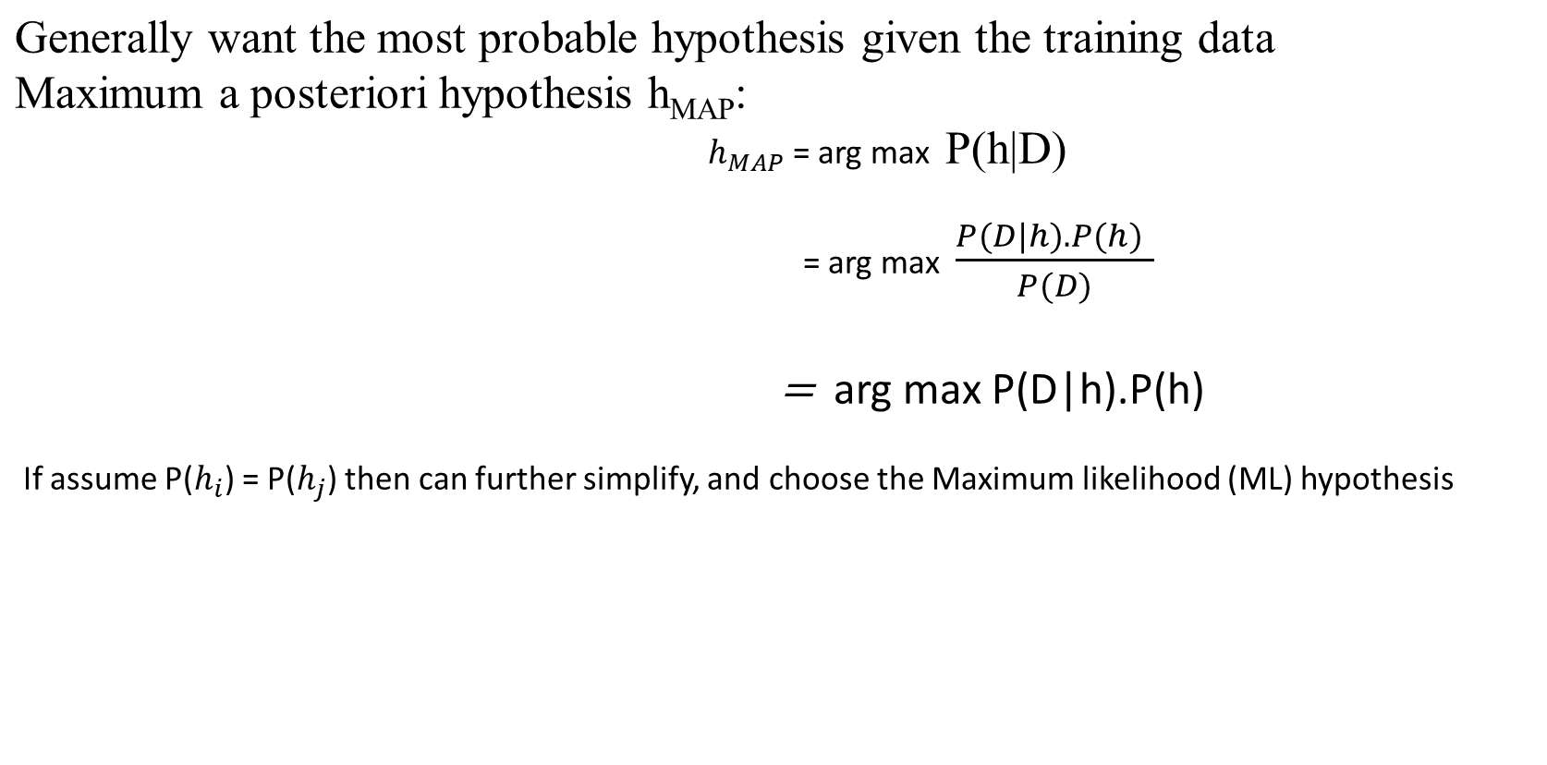




Choosing hypothesis

Slide 21
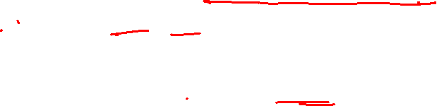
Bayes Theorem: Example : 5
Weather | Play
Sunny | No
Overcast | Yes
Rainy | Yes
Sunny | Yes
Sunny | Yes
Overcast | Yes
Rainy | No
Rainy | No
Sunny | Yes
Rainy | Yes
Sunny | No
Overcast | Yes
Overcast | Yes
Rainy | No
If the weather is sunny, Then the player will play or not? i.e., Play /sunny = Yes or No.
Note: If we know P(Yes/Sunny) and P(No/Sunny)
then we can answer the question asked

Slide 22
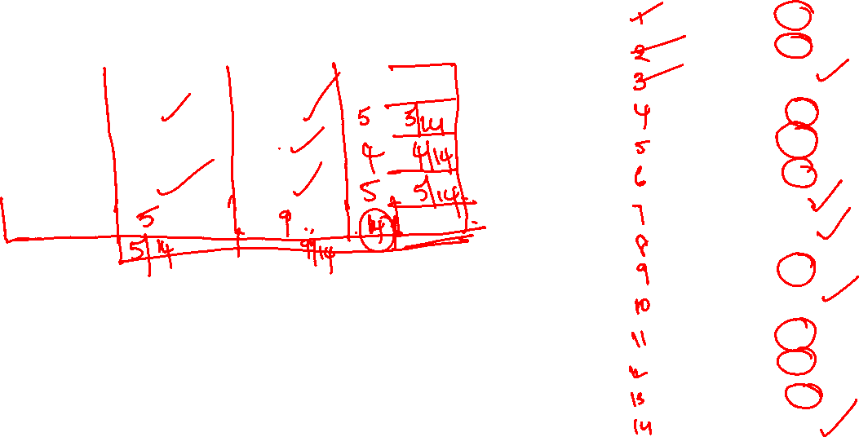

Steps to Apply Bayes Theorem
Weather | Play
Sunny | No
Overcast | Yes
Rainy | Yes
Sunny | Yes
Sunny | Yes
Overcast | Yes
Rainy | No
Rainy | No
Sunny | Yes
Rainy | Yes
Sunny | No
Overcast | Yes
Overcast | Yes
Rainy | No
Step1: View or Collect “raw” data
Step2: Convert long data into frequency table
Weather | No | Yes
Sunny | 2 | 3
Overcast | 0 | 4
Rainy | 3 | 2
Step3: Row and Column sums to get Probabilities
Weather Probabilities: Sunny =5/14,Rainy=5/14,Overcast= 4/14
Play Probabilities :
No =5/14
Yes =9/14

Slide 23
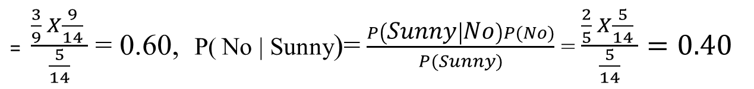

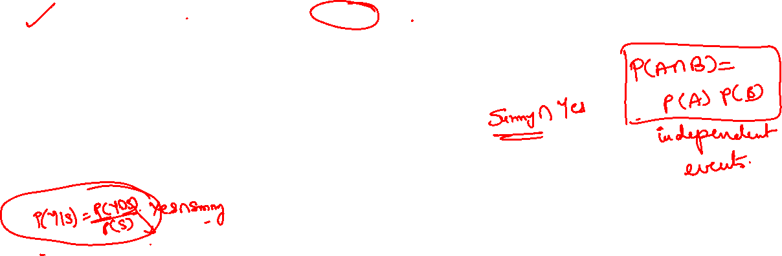
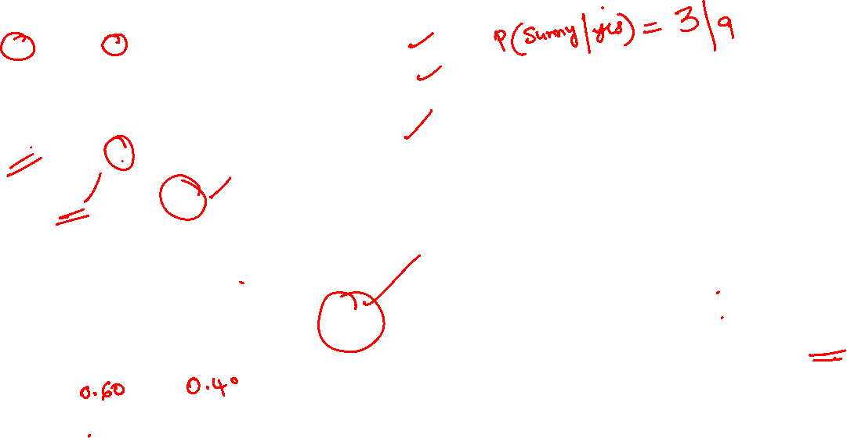
continuation
Weather | No | Yes | Row Total
Sunny | 2 | 3 | 5 | P(sunny)= 5/14
Overcast | 0 | 4 | 4 | P(overcast)=4/14
Rainy | 3 | 2 | 5 | P(Rainy)= 5/14
Column Total | 5 | 9 | 14
 | P(no)=5/14 | P(yes)=9/14
Step4: Apply Probabilities from frequency table to Bayes Theorem
P( Yes | Sunny) > P( No | Sunny) . Hence, The Player will play the game.

Slide 24
Bayesian Learning
Naive Bayes is a set of simple and efficient machine learning algorithms for solving a variety of classification and regression problems.
Naive Bayes assumes conditional independence where Bayes theorem does not. This means
the relationship between all input features are independent.
Bayesian learning algorithms that calculate explicit probabilities for hypotheses, such as the Naive Bayes classifier, are among the most practical approaches to certain types of learning problems.
Example:
Problem of learning to classify text documents such as electronic news articles.
For such learning tasks, the Naive Bayes classifier is among the most effective known algorithms.

Slide 25
Naive Bayes Classifier
In Naive Bayes, we classify data based on conditional probabilities:
𝑃(𝑋 ∣ 𝐶)𝑃(𝐶)
𝑃(𝐶 ∣ 𝑋) =
𝑃(𝑋)
C: Class label (hypothesis).
X: Feature vector (evidence).
The sum of probabilities over all possible classes 𝐶₁, 𝐶₂, … , 𝐶_{𝑛} is always 1:
𝑛
෍ 𝑃(𝐶_{𝑖} ∣ 𝑋) = 1
𝑖=1
This is because the Naive Bayes classifier calculates probabilities for a set of mutually exclusive and
exhaustive classes. The denominator P(X) normalizes the probabilities, ensuring they sum to 1.

Slide 26
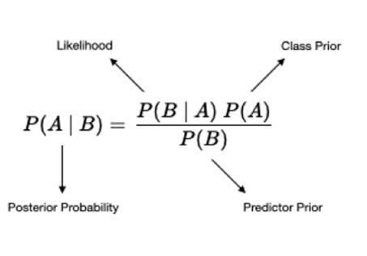
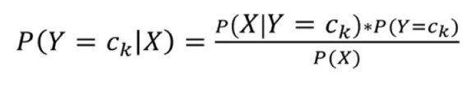
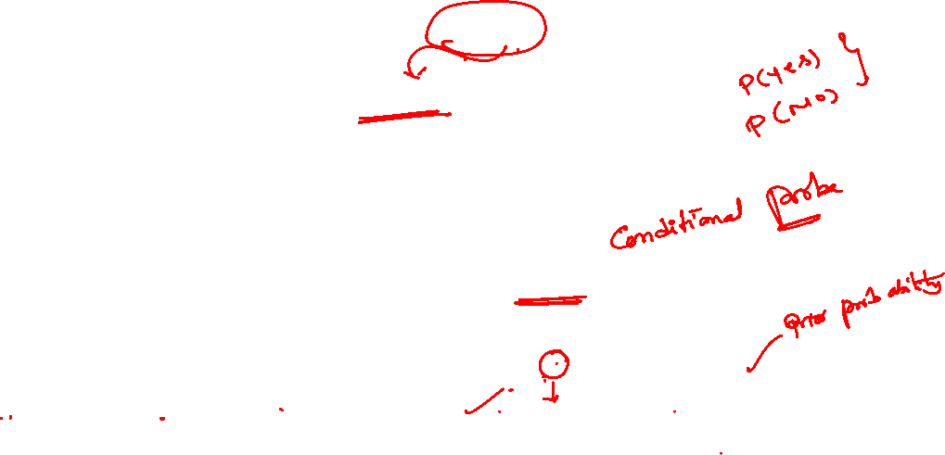
Generative Model
Build model to estimate the posterior probability P(Y | X) by estimating
likelihood of data given target (hypothesis) P(X | Y)
Prior probabilities over target P(Y)
In general, for a specific class Y=ck,
𝑃(𝑋 ∣ 𝐶)𝑃(𝐶)
𝑃(𝐶 ∣ 𝑋) =
𝑃(𝑋)

Slide 27

Conditional Independence
Naive Bayes assumes conditional independence where Bayes theorem does not. This
means the relationship between all input features are independent.
Definition: 𝑋 is conditionally independent of 𝑌 given 𝑍, if the probability distribution
governing 𝑋 is independent of the value of 𝑌, given the value of 𝑍
∀𝑖, 𝑗, 𝑘 𝑃 𝑋 = 𝑥_{𝑖} 𝑌 = 𝑦_{𝑗}, 𝑍 = 𝑧_{𝑘}) = 𝑃(𝑋 = 𝑥_{𝑖}|𝑍_{𝑘})
𝑃 𝑋 𝑌, 𝑍 = 𝑃(𝑋|𝑍)
Example: 1. 𝑃 Thunder Rain, Lightning = 𝑃(Thunder|Lightning)
2. 𝑃 𝑓𝑙𝑢 fever, blood test for flu = 𝑃 𝑓𝑙𝑢 blood test for flu

Slide 28
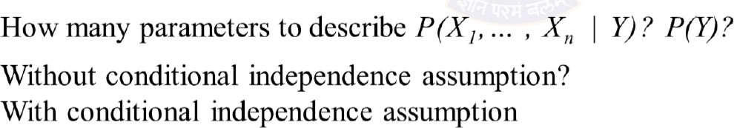
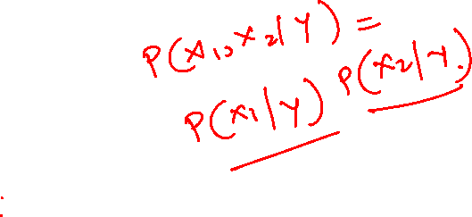
Naïve Bayes assumes 𝑿_{𝒊} are conditionally independent given 𝒀
Applying Conditional Independence
e.g., 𝑃 𝑋₁ 𝑋₂, 𝑌 = 𝑃(𝑋₁|𝑌)
𝑃 𝑋₁, 𝑋₂ 𝑌
= 𝑃 𝑋₁ 𝑋₂, 𝑌 𝑃 𝑋₂ 𝑌
= 𝑃 𝑋₁ 𝑌 𝑃(𝑋₂|𝑌)
_{= ς}𝑛
General form: 𝑃 𝑋₁, ⋯ , 𝑋_{𝑛} 𝑌
𝑃(𝑋_{𝑗}|𝑌)
𝑗=1

Slide 29
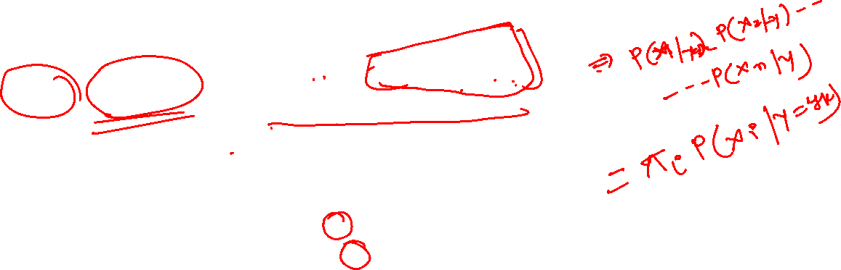
Naive Bayes Classifier
Bayes rule:
𝑃 𝑌 = 𝑦_{𝑘} 𝑋₁, ⋯ , 𝑋_{𝑛}) =
𝑃(𝑌=𝑦_{𝑘})𝑃(𝑋₁,⋯,𝑋_{𝑛} 𝑌=𝑦_{𝑘}
σ
𝑃 𝑌=𝑦_{𝑗} 𝑃 𝑋₁, ⋯ , 𝑋_{𝑛} 𝑌 = 𝑦_{𝑗}
𝑗
Assume conditional independence among 𝑿_{𝒊}’s:
𝑃 𝑌 = 𝑦_{𝑘} 𝑋₁, ⋯ , 𝑋_{𝑛}) =
𝑃 𝑌=𝑦_{𝑘} Π_{𝑖}𝑃 𝑋_{𝑖} 𝑌=𝑦_{𝑘})
σ_{𝑗} 𝑃 𝑌=𝑦_{𝑗} Π_{𝑖}𝑃 𝑋_{𝑖} 𝑌=𝑦_{𝑗})
Pick the most probable (MAP) Y
𝑌෠ ← argmax 𝑃 𝑌 = 𝑦_{𝑘} Π_{𝑖}𝑃 𝑋_{𝑖} 𝑌 = 𝑦_{𝑘})
𝑦_{𝑘}
New point is classified to Y_{k} if P(Y_{k}) Π P(X_{i}| Y_{k}) is maximal.

Slide 30
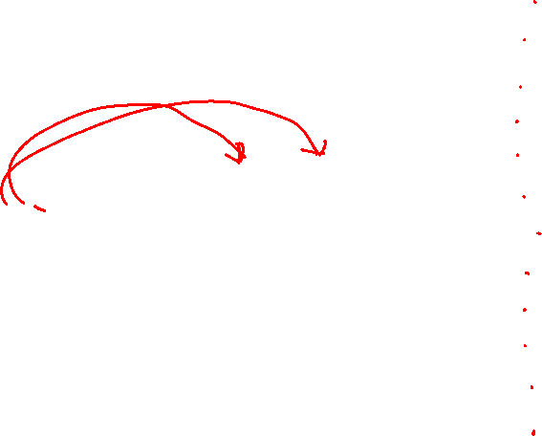
Example 1:
Email word | Spam | Email word | Spam
Dear | Yes | Friend | No
Friend | No | Friend | Yes
Dear | No | Dear | No
Dear | No | Lunch | No
Dear | No | Friend | No
Friend | No | Dear | No
Lunch | No | Dear | No
Friend | No | Dear | No
Lunch | No | Dear | No
Dear | Yes | Money | Yes
Money | Yes | Money | No
Money | Yes | Money | Yes
Suppose we got the new message with the words ‘Dear Friend’, Decide whether this new message is a normal or spam message?
i.e. Normal/ Dear, Friend = Yes or No Note if we know P (Normal/ Dear,
Friend ) and P(Spam/ Dear, Friend )
then we can answer the question asked

Slide 31
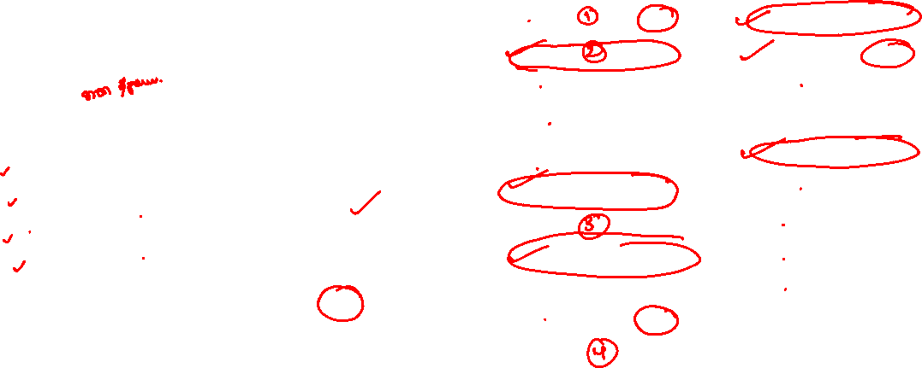
Example 1: Solution
Step 1- View or collect “raw” data.
Step 2 - Convert long data to a frequency table
Email word | Spam | Email word | Spam
Dear | Yes | Friend | No
Friend | No | Friend | Yes
Dear | No | Dear | No
Dear | No | Lunch | No
Dear | No | Friend | No
Friend | No | Dear | No
Lunch | No | Dear | No
Friend | No | Dear | No
Lunch | No | Dear | No
Dear | Yes | Money | Yes
Money | Yes | Money | No
Money | Yes | Money | Yes
normal word | spam | Row Total
Dear 8 | 2 | 10
Friend 5 | 1 | 6
Lunch 3 | 0 | 3
Money 1 | 4 | 5
Column Total 17 | 7 | 24
Step 3 - Row and column sums to get probabilities

Slide 32
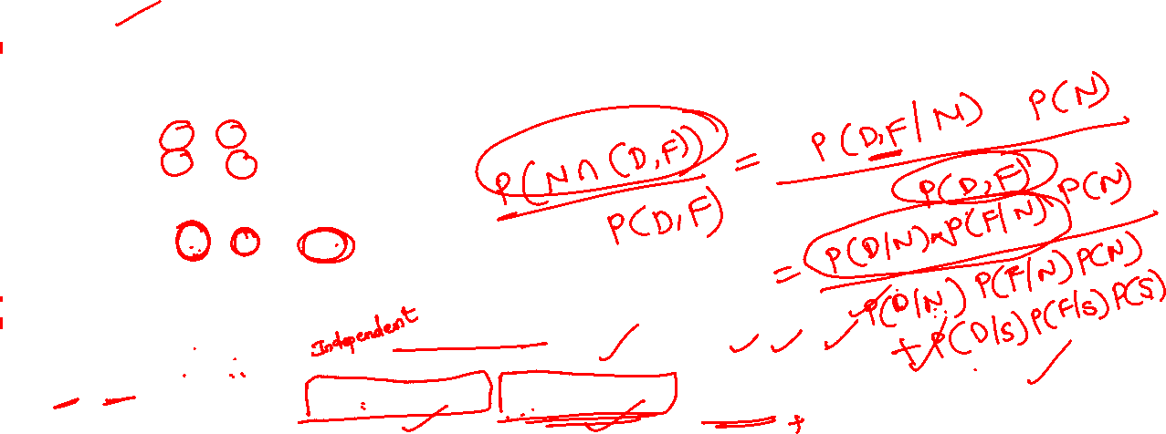
Example 1: Solution
Play
normal spam Row Total
As P (N/ D, F ) > P (S/ D, F ) , we can decide that Dear Friend is Normal message.
word
Dear | 8 | 2 | 10
Friend | 5 | 1 | 6
Lunch | 3 | 0 | 3
Money | 1 | 4 | 5
Column Total | 17 | 7 | 24
Step 4 - Apply probabilities from frequency table to Navie Bayes theorem
P (D, F/N ).P(N) P (D/N ).P(F/N).P(N)
8 5 . 17
P (N/ D, F )=
=
=
.
=
0.098
0.11
=0.891
17 17 24
8 5 . 17 ₊ 2 . 1 .
17
P (D, F) P (D/N ).P(F/N).P(N)+P (D/S ).P(F/S).P(S)
.
7
17 24 7 7 24
P (D, F/S ).P(S) P (D/S ).P(F/S).P(S)
2 . 1 . 7
0.012
0.11
P (S/ D, F )=
=
=
7 7 24
=
=0.109
8 5 . 17 ₊ 2 . 1 .
17
P (D, F) P (D/N ).P(F/N).P(N)+P (D/S ).P(F/S).P(S)
.
7
17 24 7 7 24

Slide 33

Example 1: Continued
Email word | Spam | Email word | Spam
Dear | Yes | Friend | No
Friend | No | Friend | Yes
Dear | No | Dear | No
Dear | No | Lunch | No
Dear | No | Friend | No
Friend | No | Dear | No
Lunch | No | Dear | No
Friend | No | Dear | No
Lunch | No | Dear | No
Dear | Yes | Money | Yes
Money | Yes | Money | No
Money | Yes | Money | Yes
Suppose we got the new message contains the word ‘Lunch Money Money Money Money’ , Decide whether this new message is a normal or spam message?

Slide 34
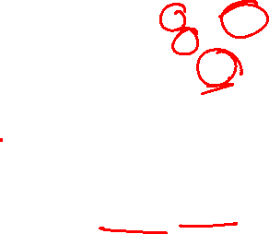
Example 1: Solution
Play
normal spam Row Total
We can observe that we have to classify any message with Lunch as Normal message, no matter how many times we see the word Money and that’s the problem.
word
Dear | 8 |  | 2 |  | 10
Friend | 5 |  | 1 |  | 6
Lunch | 3 |  | 0 |  | 3
Money | 1 |  | 4 |  | 5
Column Total |  | 17 |  | 7 | 24
Issue with Naïve Bayes classifier:
will not be able to classify as Normal or Spam!
Step 4 - Apply probabilities from frequency table
17
24
3
17
1
17
4
=0.0000015
To work around this problem add 1 count to the frequency table to each word. (Laplace smoothing)
P(N). P(L/N). P(M/N)⁴=
.
.
7
24
0
7
4
7
4
=0
P(S). P(L/S). P(M/S)⁴=
.
.

Slide 35

Example 1: Solution
Play
normal spam Row Total
As P (S/ L, M⁴ ) > P (N/ L, M⁴ ) , we can decide that Lunch Money Money Money Money is Spam message.
word
Dear | 8+1 | 2+1 | 12
Friend | 5+1 | 1+1 | 8
Lunch | 3+1 | 0+1 | 5
Money | 1+1 | 4+1 | 7
Column Total | 21 | 11 | 32
Step 4 - Apply probabilities from frequency table
21
32
4
21
2
21
4
=0.00001
P(N). P(L/N). P(M/N)⁴=
.
.
11
32
1
11
5
11
4
=0.00133
P(S). P(L/S). P(M/S)⁴=
.
.

Slide 36
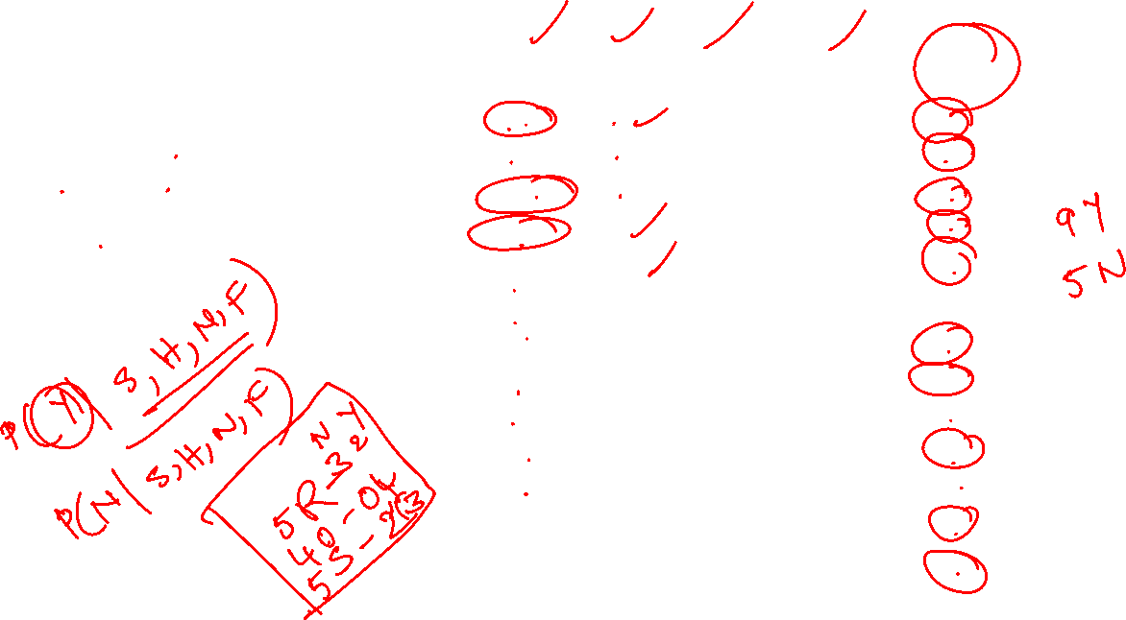
Example :2
If the feature of
Today = (Outlook is Sunny , Temp is Hot,
Humidity is Normal,
Windy is False), then the player will play or not?
S. No | Outlook | Temp | Humidity | Windy | Play Tennis
1 | Rainy | Hot | High | False | No
2 | Rainy | Hot | High | True | No
3 | Overcast | Hot | High | False | Yes
4 | Sunny | Mild | High | False | Yes
5 | Sunny | Cool | Normal | False | Yes
6 | Sunny | Cool | Normal | True | No
7 | Overcast | Cool | Normal | True | Yes
8 | Rainy | Mild | High | False | No
9 | Rainy | Cool | Normal | False | Yes
10 | Sunny | Mild | Normal | False | Yes
11 | Rainy | Mild | Normal | True | Yes
12 | Overcast | Mild | High | True | Yes
13 | Overcast | Hot | Normal | False | Yes
14 | Sunny | Mild | High | True | No

Slide 37
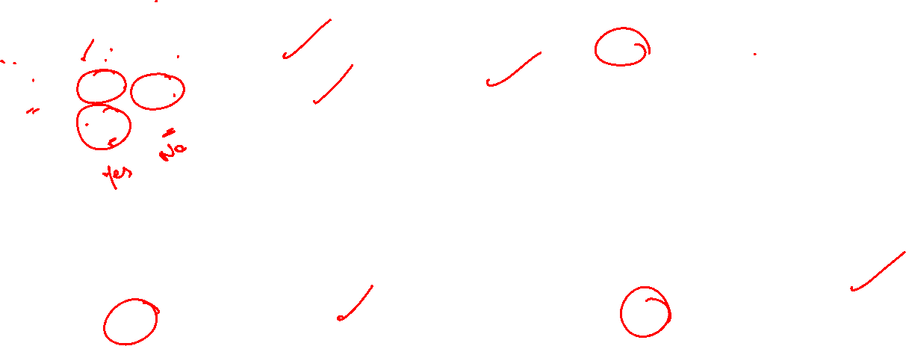
Example 2 Solution:
Outlook | Yes | No
Rainy | 2/9 | 3/5 | 5/14
Overcast | 4/9 | 0/5 | 4/14
Sunny | 3/9 | 2/5 | 5/14
Temp | Yes | No
Hot | 2/9 | 2/5 | 4/14
Mild | 4/9 | 2/5 | 6/14
Cool | 3/9 | 1/5 | 4/14
Humidity | Yes | No
High | 3/9 | 4/5 | 7/14
Normal | 6/9 | 1/5 | 7/14
Windy | Yes | No
True | 3/9 | 3/5 | 6/14
False | 6/9 | 2/5 | 8/14

Slide 38
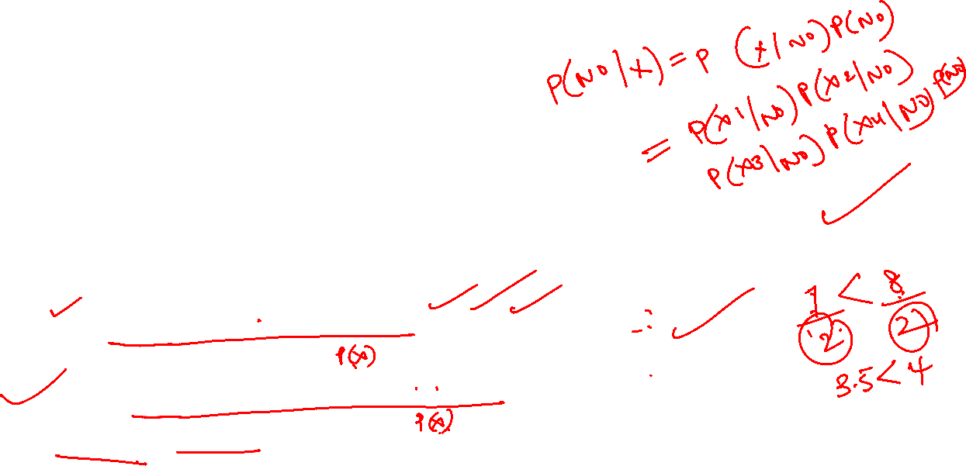
Example 2 Solution:
𝑃 𝑌𝑒𝑠 = ⁹ , 𝑃 𝑁𝑜 = 5/14
14
Today = (Sunny, Hot, Normal, False)
Let Today = X, Sunny = 𝑋₁, Hot = 𝑋₂,Normal = 𝑋₃,False = 𝑋₄
𝑃
𝑋₁ 𝑋₂
𝑋₃ 𝑋₄
𝑃(𝑋/𝑌𝑒𝑠) 𝑃(𝑌𝑒𝑠) 𝑃(𝑋₁,𝑋₂,𝑋₃,𝑋₄/𝑌𝑒𝑠) 𝑃(𝑌𝑒𝑠)
P(Yes/ X) = = =
𝑃(𝑋) 𝑃(𝑋₁,𝑋₂,𝑋₃,𝑋₄)
𝑃 𝑃 𝑃
.𝑃(𝑌𝑒𝑠)
𝑦𝑒𝑠 𝑦𝑒𝑠 𝑦𝑒𝑠 𝑦𝑒𝑠
𝑃(𝑋₁,𝑋₂,𝑋₃,𝑋₄)
𝑋₁ 𝑋₂ 𝑋₃ 𝑋₄
₌ 3 2 6 6 × 9
9
Consider 𝑃 𝑃 𝑃 𝑃 . 𝑃 𝑌𝑒𝑠
× × ×
=0.021
𝑦𝑒𝑠 𝑦𝑒𝑠 𝑦𝑒𝑠
𝑦𝑒𝑠
9
9 9 14
Similarly for P(No/X)
₌ 2 2 1 2
5 5
𝑋₁ 𝑋₂
𝑋₃
𝑋₄
5
Consider 𝑃 𝑃 𝑃 𝑃 . 𝑃 𝑛𝑜
× × × ×
=0.005
𝑛𝑜 𝑛𝑜 𝑛𝑜 𝑛𝑜 5 5
14
P( Yes/X) > P(No/X) . Hence, Player will play Tennis.

Slide 39
Example:3
Estimate Conditional Probability of each attributes {colour, legs, height, smelly} for the species classes:
{ S1, S2 } using the data given in the
table.
Using these probabilities in the table estimate the probabilities values for the
new instance – { Colour =Green , Legs
= 2, Height = Tall and Smelly= No}
No | Colour | Legs | Height | Smelly | Species
1 | White | 3 | Short | Yes | S1
2 | Green | 2 | Tall | No | S1
3 | Green | 3 | Short | Yes | S1
4 | White | 3 | Short | Yes | S1
5 | Green | 2 | Short | No | S2
6 | White | 2 | Tall | No | S2
7 | White | 2 | Tall | No | S2
8 | White | 2 | Short | Yes | S2

Slide 40

Example 3 Solution:
P(S1)= , P(S2)= ,
Legs | S1 | S2
2 | ¼ | 4/4
3 | ¾ | 0/4
Colour | S1 | S2
White | 2/4 | 3/4
Green | 2/4 | 1/4
Smelly | S1 | S2
Yes | ¾ | ¼
No | ¼ | 3/4
Height | S1 | S2
Tall | ¾ | 2/4
Short | ¼ | 2/4

Slide 41
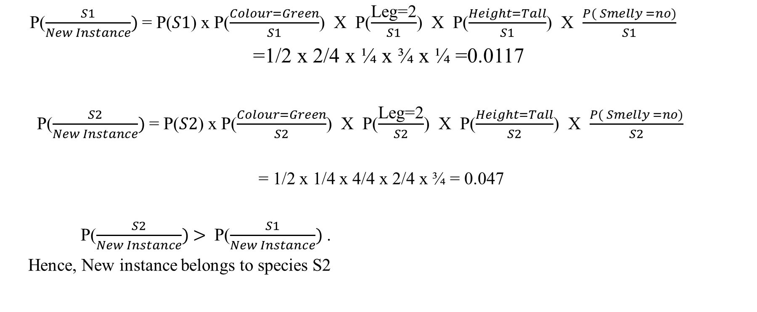

Example 3 Solution:

Slide 42
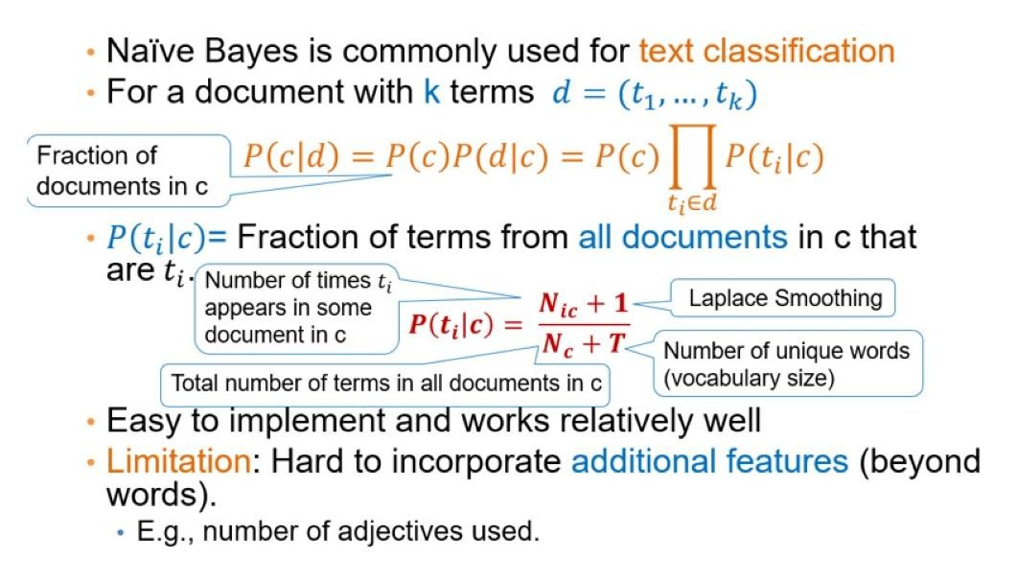

Naïve Bayes for Text Classification

Slide 43

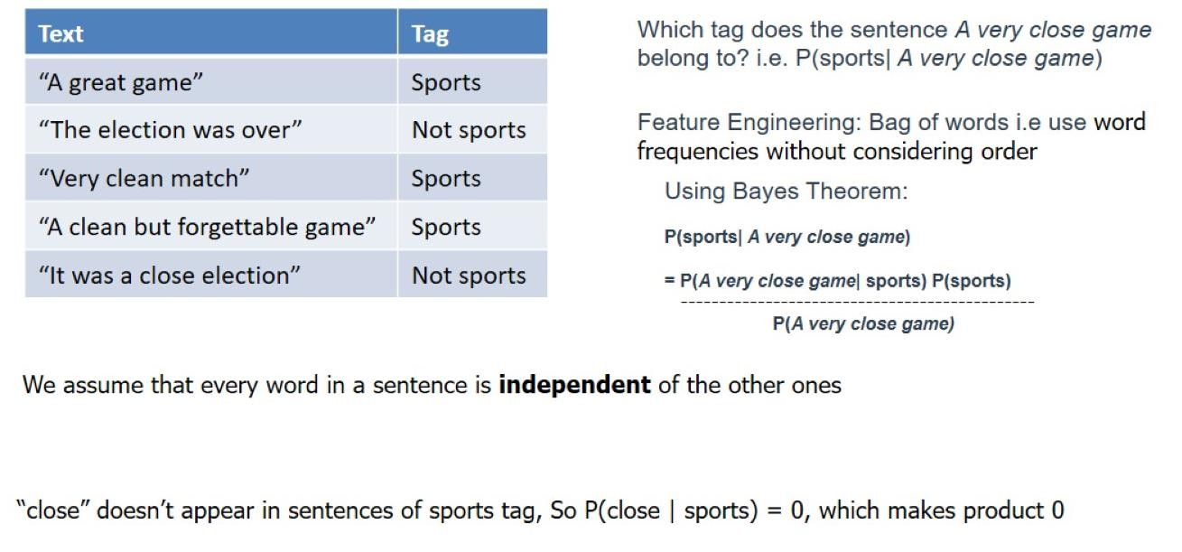
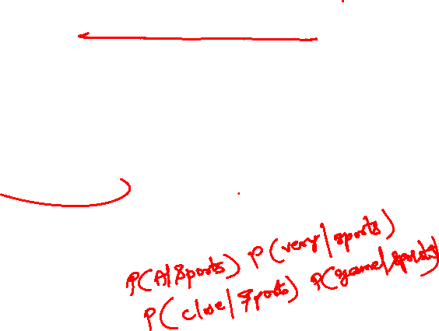
Example 4:

Slide 44
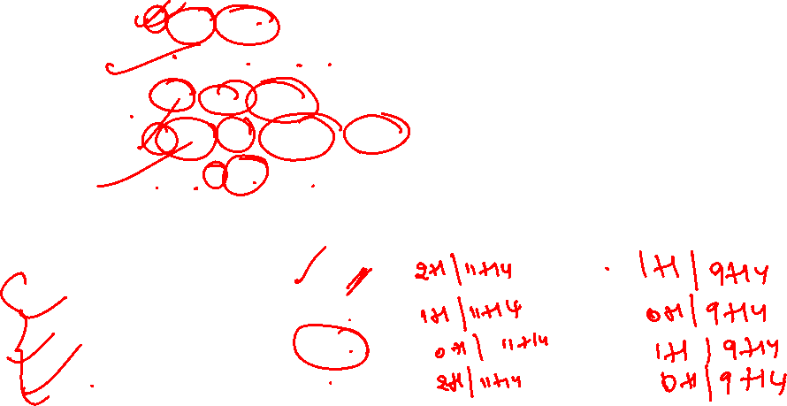
Example 4 Solution: Apply Laplace smoothing
Text | Tag
“A great game” | Sports
“The election was over” | Not sports
“Very clean match” | Sports
“A clean but forgettable game” | Sports
“It was a close election” | Not sports
Word | P(Word/Sport) | P(Word/Not Sport)
a | 2/11 | 1/9
very | 1/11 | 0/9
close | 0/11 | 1/9
game | 2/11 | 0/9

Slide 45

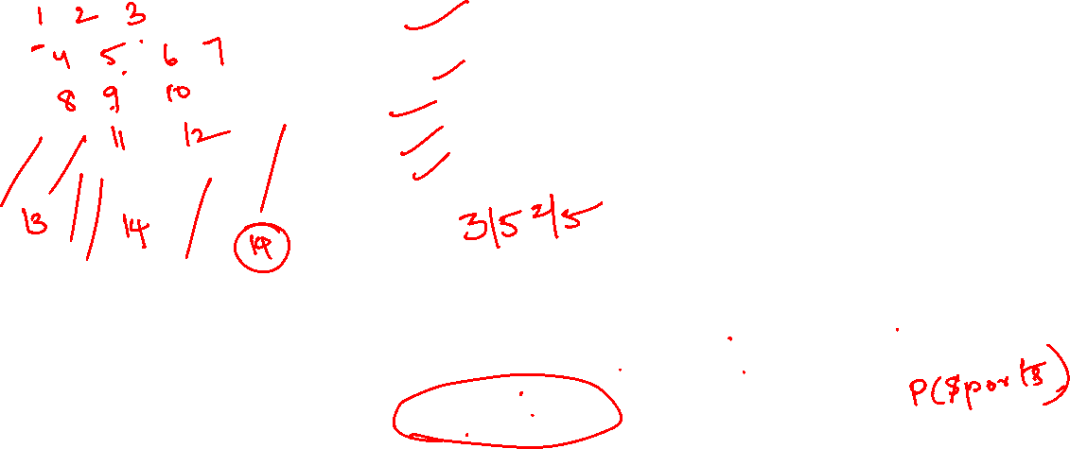
Example 4 Solution:
Text | Tag
“A great game” | Sports
“The election was over” | Not sports
“Very clean match” | Sports
“A clean but forgettable game” | Sports
“It was a close election” | Not sports
Which tag does the sentence A very close game belong to? i.e. P(sports| A very close game)
Using Bayes Theorem:
P(sports| A very close game)
= P(A very close game| sports) P(sports)
----------------------------------------------
P(A very close game)
We assume that every word in a sentence is independent of the other ones
“close” doesn’t appear in sentences of sports tag, So P(close | sports) = 0, which makes product 0

Slide 46
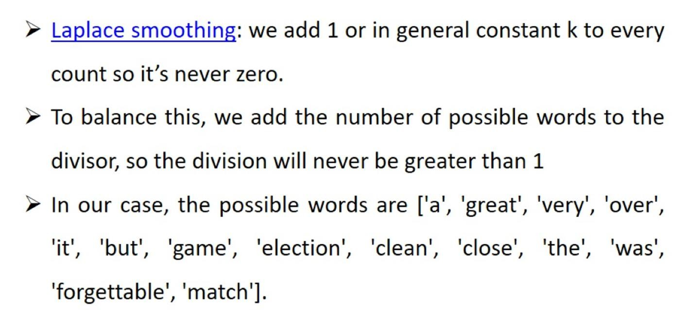

Example 4 Solution: Laplace smoothing

Slide 47
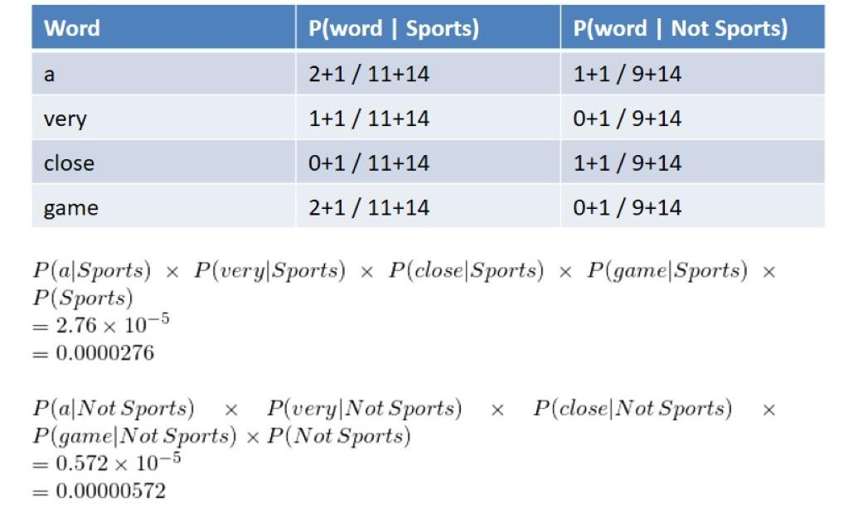
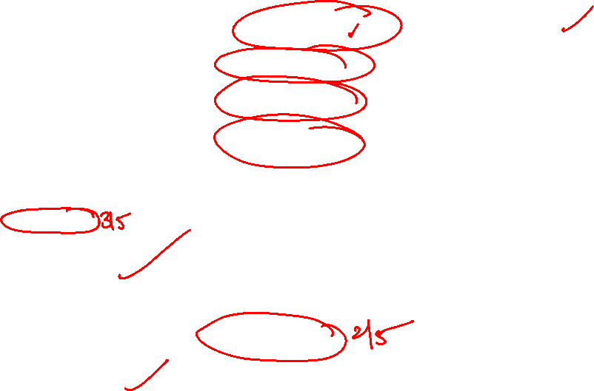
Example 4 Solution: Apply Laplace smoothing

Slide 48
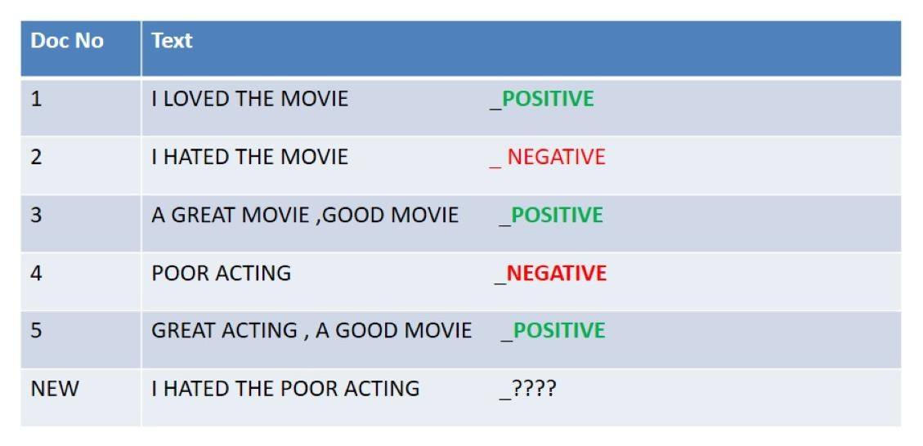
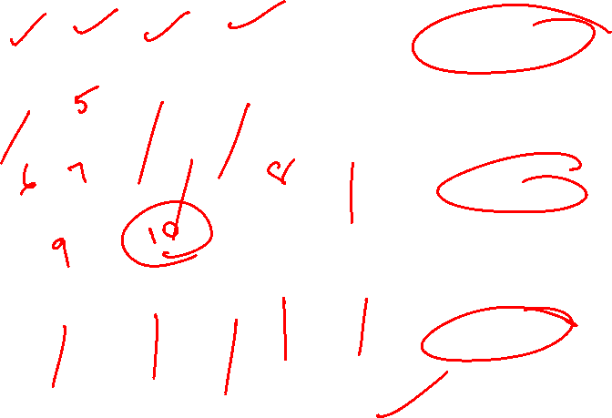
Example 5:

Slide 49
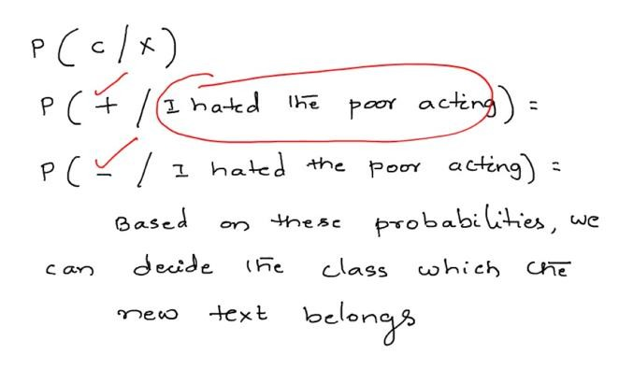
Example 5 Solution:

Slide 50
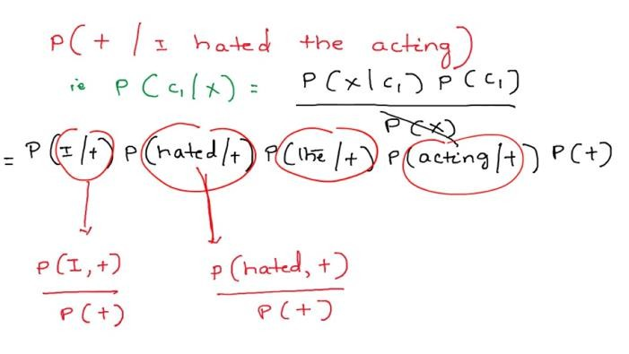

Example 5 Solution:

Slide 51
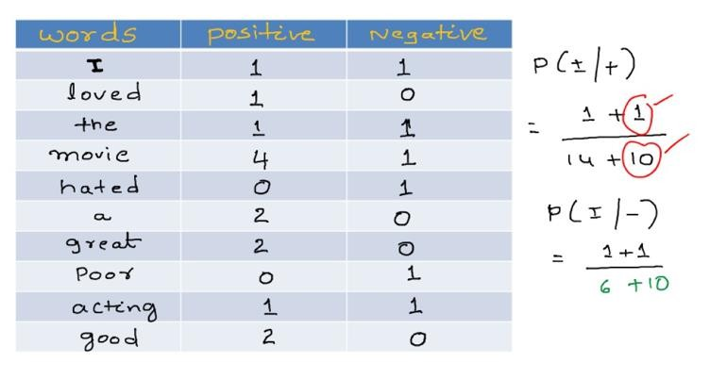


Example 5 Solution:

Slide 52

Example 5 Solution:

Slide 53





Example 5 Solution:

Slide 54

Naïve Bayes Classifier Applications

Slide 55

Practical Issues of Bayesian learning

Slide 56

Practical Issues of Bayesian learning

Slide 57
Glossary
Bayes theorem
MAP Hypothesis
ML Estimate
Naïve Bayes theorem
NB with Laplace correction

Slide 58
Practice Problems 1
Two set of candidates are competing for the positions on the board of directors of a
company. The probabilities that the first and the second sets will win are 0.6 and 0.4 respectively. If the first set wins , the probability of introducing a new product is 0.8,
and the corresponding probability if the second set wins is 0.3. What is the probability
that the product will be introduced?

Slide 59

Solution

Slide 60

Practice Problems 2

Slide 61

Solution

Slide 62




Conti..
TREE DIAGRAM
E
E1
0.35
E
E
E

Slide 63

Practice Problems 3

Slide 64

Solution

Slide 65


Practice Problems 4
The chances that an academician, a business man and a politician becoming Vice Chancellor of an university are 0.5, 0.3 and 0.2 respectively. The probability that research work will be promoted in the university by these 3 gentlemen are respectively are 0.8, 0.6 and 0.4. It is
found Research work has been promoted by the university. academician has become the VC?
Solution:
What is the chance that an

Slide 66

Conti..

Slide 67

Practice Problems 5

Slide 68

Solution

Slide 69
Practice Problems 6
Seventy percent of the light aircraft that disappear while in flight in a certain country are subsequently discovered. Of the aircraft that are discovered,60% have an emergency locator, whereas 90% of the aircraft not discovered do not have such a locator. Suppose that a light aircraft has disappeared.
If it has an emergency locator, find the probability that it will not be discovered.
(b) If it doesn’t have a locator, find the probability that it will be discovered.

Slide 70
Solution
The tree diagram below shows the probability for the four disjoint options;
P(the flight is discovered and has a locator)
= P(discovered)P(locator | discovered)
= (.7)(.6) = .42.

Slide 71
Practice Problems 7
Two firms V and W consider bidding on a road-building job, which may or may not be awarded depending on the amounts of the bids. Firm V submits a bid and the probability is 3/4 that it will get the job provided firm W does not bid. The probability is 3/4 that W will bid, and if it does, the probability that V will get the job is only 1/3. (a) what is the probability that V will get the job? (b) If V gets the job, what is the probability that W did not bid?

Slide 72

Solution

Slide 73

Thank you

